Slide 1
Database System (CS-406)
Lecture 01
Introduction to Database System
Ms. Rabia Gul
Lecturer, ITC

Slide 2
Course Outline
Introduction to Databases
Database Environment
The Relational Model
Relational Algebra and Relational Calculus
SQL: Data Manipulation
SQL: Data Definition

Slide 3
Course Outline
Database Planning, Design, and Administration
Entity-Relationship Modeling
Enhanced Entity-Relationship Modeling
Normalization
Advanced Normalization
Design Methodologies

Slide 4
Books to follow
An Introduction to Database Systems, Date, C. J. 8th Edition, Addison Wesley, 2003.
Database Systems: A Practical Approach to Design, Implementation, and Management, Connolly, T. M., and Begg, C. E. 6th Edition, Addison Wesley, 2015.

Slide 5
Introduction
Data :
Data is raw, unorganized facts that need to be processed. Data can be something simple and seemingly random and useless until it is organized. Data are simply facts or figures. The term "Data" comes from a singular Latin word, datum.
Information :
When data is processed, organized, structured or presented in a given context so as to make it useful, it is called information.

Slide 6
Examples of Data and Information
The history of temperature readings all over the world for the past 100 years is data. If this data is organized and analyzed to find that global temperature is rising, then that is information.
The number of visitors to a website by country is an example of data. Finding out that traffic from the U.S. is increasing while that from Australia is decreasing is meaningful information.

Slide 7
Introduction to Database
Definition 01:
A collection of logically related data is called a database.
Example: A database may contains part numbers, product codes, customer information, etc.
It usually refers to data organized and stored on a computer that can be searched and retrieved by a computer program.

Slide 8
Introduction to Database
Definition 02:
A collection of information organized and presented to serve a specific purpose. (A telephone book is a common database.) A computerized database is an updated, organized file of machine readable information that is rapidly searched and retrieved by computer.
Salesperson may contain a small database of customer contacts in an Microsoft Excel file.
A large corporation may build a large database in Oracle Database.

Slide 9
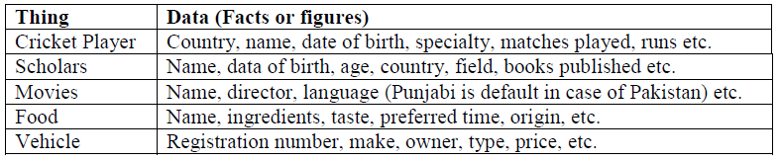
Introduction to Database
Definition 03:
A database is the collection of data about anything. Like cricket teams, students, busses, movies, personalities, stars, seas, buildings, furniture, lab equipment, hobbies, hotels, pets, countries, and many more anything about which you want to store data. What we mean by data; simply the facts or figures.

Slide 10
Database Management System (DBMS)
The database management system (DBMS) is the software or tool that is used to manage the database and its users.
A DBMS is a software that allows creation, definition and manipulation of database, allowing users to store, process and analyze data easily.
DBMS provides an interface or a tool, to perform various operations like creating database, storing data in it, updating data, creating tables in the database and a lot more.

Slide 11
Database System
It is the collection of database (to store the data) and DBMS (tool to manage this data).
Database and DBMS both jointly are called database system.
Example : MySQL, Oracle, Microsoft SQL Server….

Slide 12
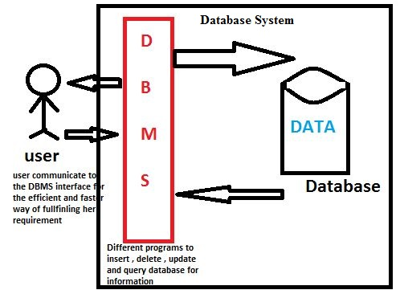
Database System

Slide 13


